Slide 1
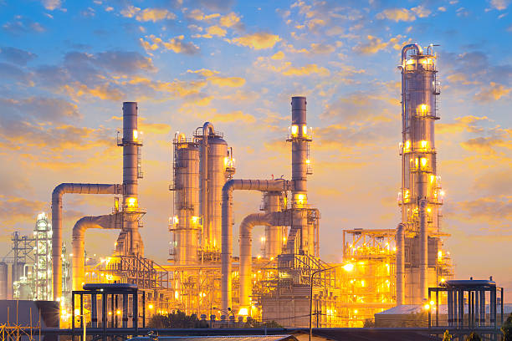
Gasoline Prices Increase
By: Monica Hawkins
October 4, 2025

Slide 2
Gasoline Prices Increase
by Monica R. Hawkins
October 4, 2025
Problem: Gasoline prices rise in the spring and summer due to increased availability. During the winter, the price typically does not rise above $ 2.00. Because refiners are operating on May 1st to transition production to a winter blend of gasoline. The refiners have individuals operating there overnight; there should be a reason why gasoline has increased so much.
Research questions:
How can we prevent the refinery from raising gas prices above $4.00?
What can we do to persuade the United States Environmental Protection Agency to look into the refinery’s decision not to switch during the winter season?
Dataset: "natural gas dataset" can refer to various sources, such as global production and trade data from the KAPSARC or EIA, U.S. domestic consumption and storage data from the EIA, U.S. well composition data from the USGS, or infrastructure details from Rextag. To
Methodology: gas refinery operations involves transforming crude oil into usable products through three main stages: separation, conversion, and treatment. In the separation phase, fractional distillation separates components by boiling point in distillation towers. The conversion stage uses processes like catalytic cracking, reforming, and alkylation to break down or restructure larger hydrocarbons into higher-value products such as gasoline
Motivation: Even if the refinery burns gasoline throughout the winter season, this does not keep the air clean. My goal is to persuade gas refinery businesses not to increase gas prices during the spring and summer months and to avoid flaring or burning during the winter season. Additionally, I recommend that refineries investigate which states have experienced the greatest growth in gas consumption and production.

